Slide 1
Epigenetics of Cardiovascular Diseases
A primer in epigenetics of cardiovascular disease

Slide 2
What we’ll discuss today…
Recapture Some Basic Genetics - again
Human Genome & Genetic Variation
GWAS & Statistics
Coronary artery disease
Intermezzo
Basic concepts epigenetics
Our research

Slide 3
The human genome
Recapturing Some Basic Genetics

Slide 4

We are all equally unique ~100 million genetic variations are known to date among ~3 billion base pairs in the human genome

Slide 5
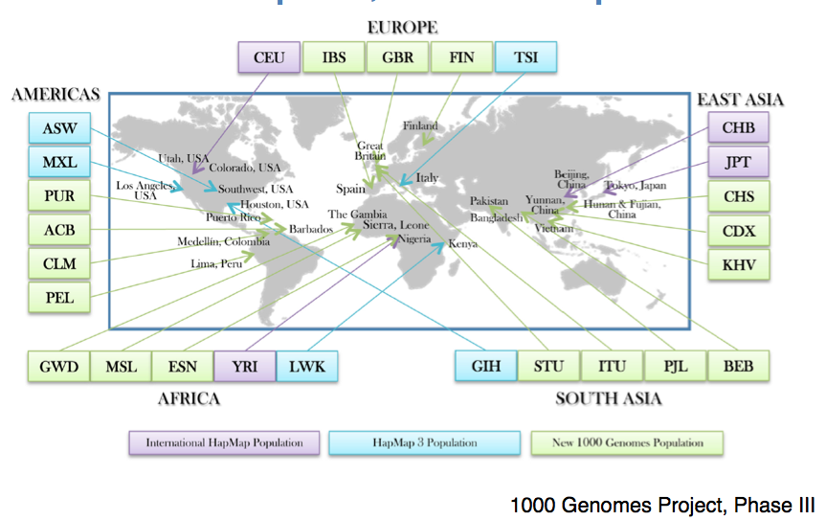
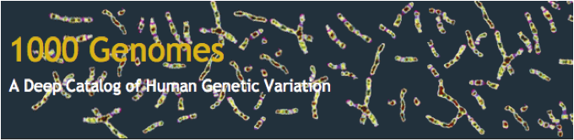
The 1000 Genomes Project

Slide 6
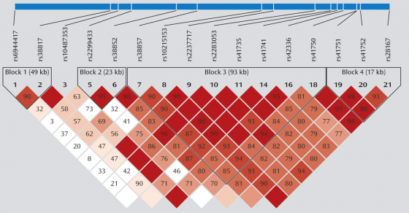

Slide 7
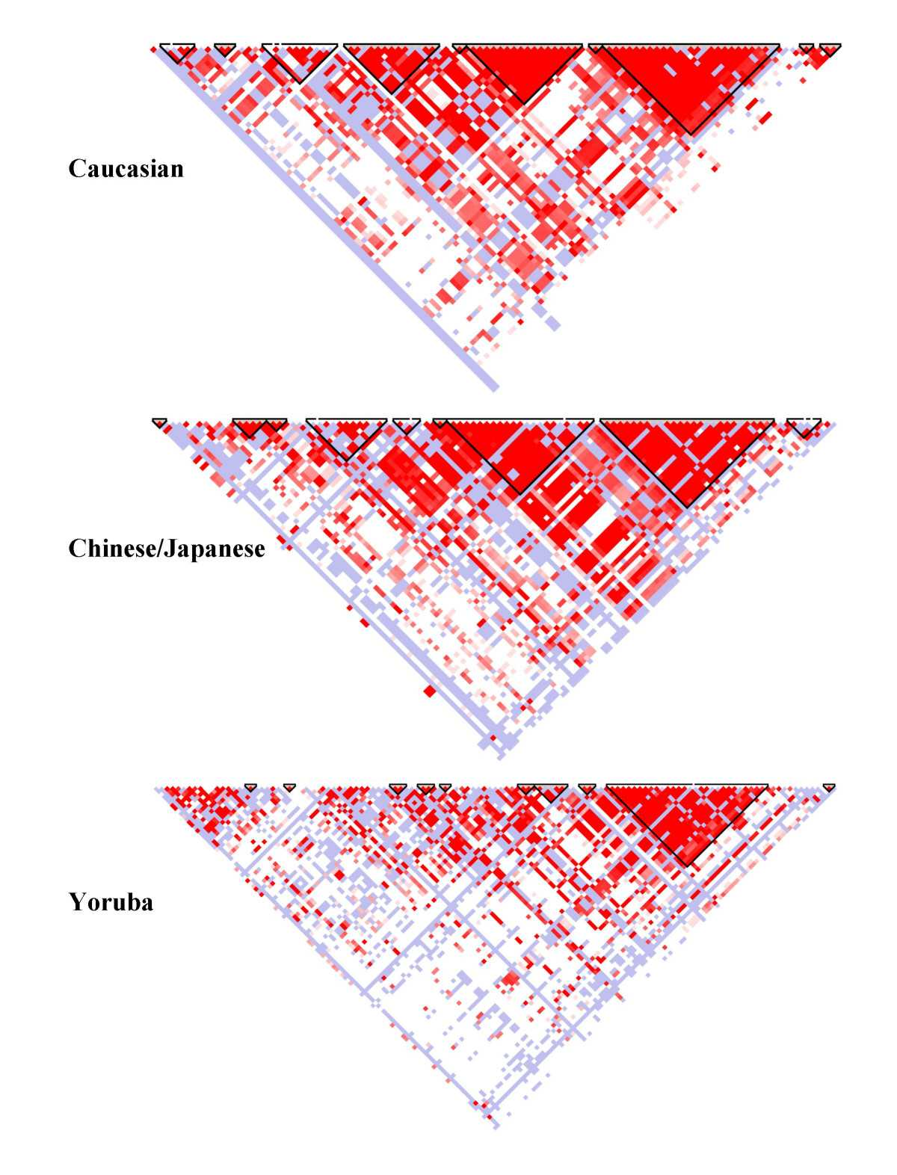

Slide 8
These genetic variants, i.e. single-nucleotide polymorphisms (SNPs), are correlated and form haplotypes
The International HapMap Project. Nature; 426:789-796; 2003
Pe’er I. Genet Epidemiol; 32(4):381-385; 2008
Dudbridge F. Genet Epidemiol; 32(3):227-234; 2008
Notes:
You could look at some part of the genome of 4 individuals – chr 1 through 4
And see that they are all the same – as we’d expect, except for three variations
It turns out there are many more
And it turns out they seem to co-occur in patterns: “haplotypes” 1 through 4
If you look closer you’d only have to look at three of those variants in these haplotypes to know what other variations these individuals must have
So: variants are correlated some more than others

Slide 9
Common diseases and traits are complex and polygenic by nature
many SNPs are involved with small effects
Asselbergs F.W., van der Laan S.W., de Bakker P.I.W. NTvG; 159:A5821; 2014
Notes:
Common diseases and traits are complex and polygenic by nature
So many variants contribute to them
And all exert a small effect

Slide 10
So now you know 3 things
We are all equally unique: ~100 million genetic variations are known to date, among ~3 billion base pairs in the human genome
These genetic variants, i.e. single-nucleotide polymorphisms (SNPs), are correlated and form haplotypes
Common diseases and traits are complex and polygenic by nature: many SNPs are involved with small effects

Slide 11
Manolio, T.A., et al. Nature; 461:747-753; 2009
monogenic
Mendelian disease
Very rare variants
Complete penetrance
oligogenic
Common disease
Effect size
Rare and low-frequency variants
Large effect size
polygenic
Common disease
Common variants Smaller effect sizes
Variant frequency
Rare (< 0.5%)
Low-frequency (0.5-5%)
Common (>5%)

Slide 12
Many factors influence complex traits and common disease
Genotype
Behavior
Disease
Chance
Environment
Notes:
Involvement of many genes and environment
Each plays only a small role (consequence - traditional approaches designed to find major genetic effects are ineffective)
Mutations are neither necessary nor sufficient on their own to cause disease
Environmental triggers are common
Inability to recognize DNA changes that have subtle functional impact from majority of variation (likely neutral)

Slide 13
Combining GWAS datasets
Illumina 1M
7,000 individuals
Affy 6.0
2,500 individuals
Results for one SNP
Illumina 1M
1,000 individuals
Illumina 1M
7,000 individuals
Illumina 2.5M
12,000 individuals
Affy 6.0
2,500 individuals
Affy 5.0
4,500 individuals
Illumina 1M
5,000 individuals
Imputation
Forest plot
Meta-analysis of GWAS
1.0
1.12
Odds ratio = ln(β)

Slide 14
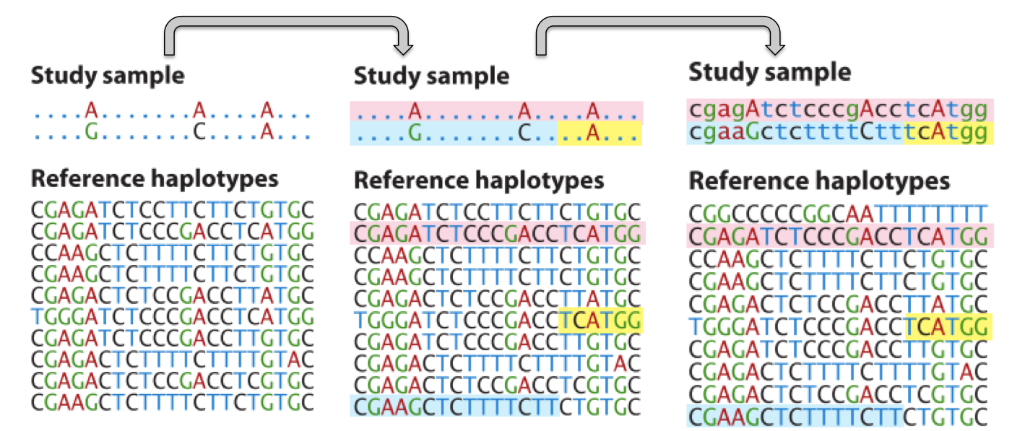
Imputation
Imputation: infer untyped genotypes based on a suitable reference panel of well-characterized and validated genotypes

Slide 16
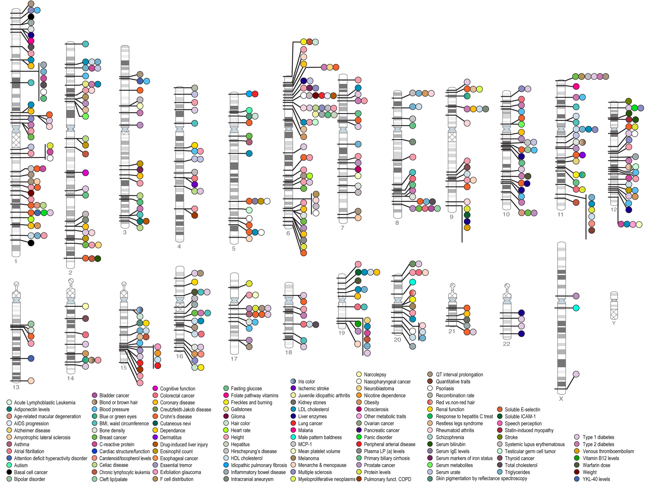

Slide 17
Intermezzo

Slide 18
Let’s count…
Tongue rollers
Asparagus smelling

Slide 19
Epigenetics

Slide 20

Case: the Hungerwinter study
Winter 1944-1945
Early winter
No supply of food and fuel (punishment for help during Market Garden)
3.5 million people
Eating flower bulbs
Burning sleepers
20.000 people died from starvation and cold

Slide 21
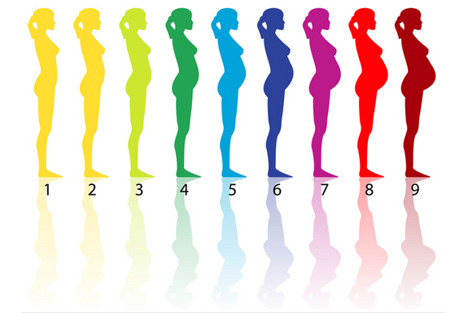
Case: the Hungerwinter study
Hungerwinter babies vs. siblings
Late
Birthweight ↓

Slide 22
Case: the Hungerwinter study
Hungerwinter babies vs. siblings
Early
Late
Birthweight ↔
Birthweight ↓

Slide 23
Case: the Hungerwinter study
Hungerwinter babies vs. siblings
Early
Late
Birthweight ↔
Birthweight ↓
Obesity later in life ↑↑
Obesity later in life ↓

Slide 24
Case: the Hungerwinter study
Hungerwinter babies vs. siblings
Early
Late
Birthweight ↔
Birthweight ↓
Obesity later in life ↑↑
Obesity later in life ↓
Environment influences phenotype on the long run…

Slide 25
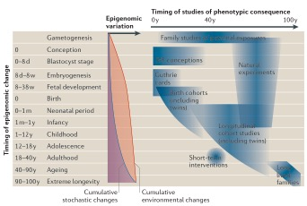
Epigenetics
Heritable variation [in gene expression] that is not based on DNA sequence variation

Slide 26
Regulating the regulation of regulatory regulators…
DNA
Transcription
RNA
Translation
protein

Slide 27
Regulating the regulation of regulatory regulators…
DNA
DNA methylation
Transcription
Histone modifications
RNA
Non-coding RNAs
Translation
protein

Slide 28
Regulating the regulation of regulatory regulators…
Methyl transferases (DNMT)
DNA
DNA methylation
Transcription
Histone modifications
RNA
Histone deacetylases (HDAC)
Non-coding RNAs
Translation
protein

Slide 29
Regulating the regulation of regulatory regulators…
Cell type specific
Methyl transferases (DNMT)
DNA
DNA methylation
Transcription
Histone modifications
RNA
Histone deacetylases (HDAC)
Non-coding RNAs
Translation
protein

Slide 30
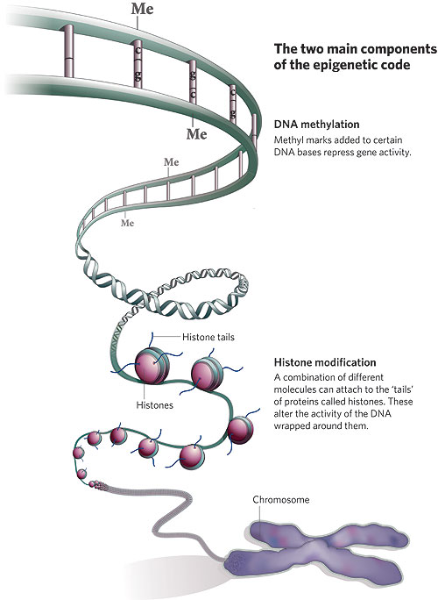
The epigenetic code

Slide 31
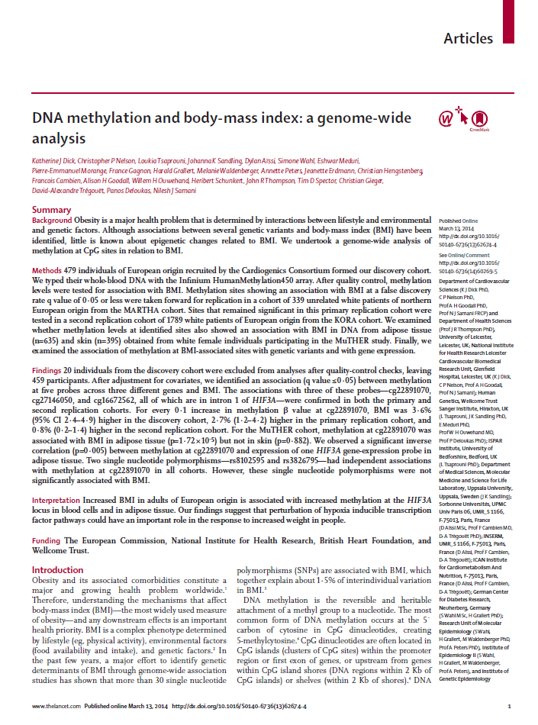
Another *WAS: Epigenome-wide association study of BMI
Dick et al. Lancet, 2014.
3 epigenetic loci associated to variability in BMI
Replicated results
Non-causal effect: Mendelian Randomization
Notes:
Shown here a recent publication from the group of Nilesh Samani, a good example of an epigenome-wide association study (EWAS)

Slide 32
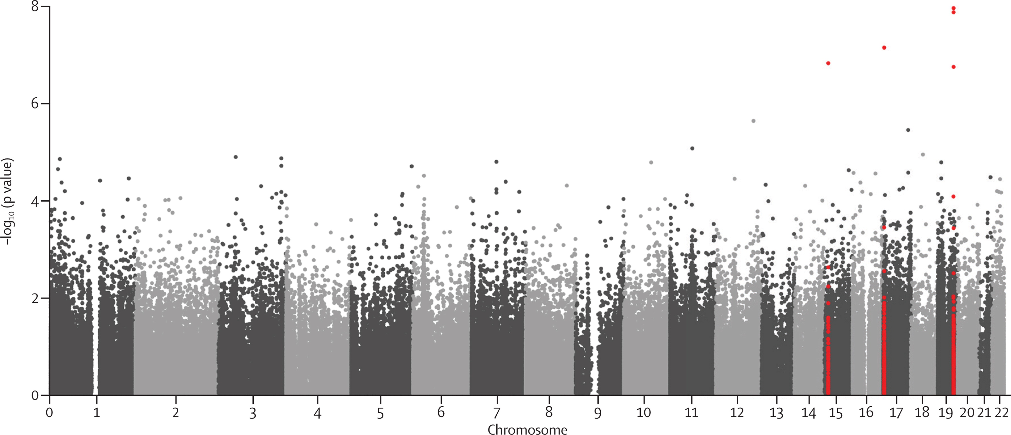
Manhattan
HIF3A
CLUH
KLF13
Notes:
Three regions show suggestive/genome-wide significant effects

Slide 33
Main results
“For every 10% increase in methylation of the most significant probe – cg22891070 – BMI increased by 3.6% (95% CI 2.4–4.9), equating to about 0.98kg/m² for a person in the discovery cohort with a BMI of 27 kg/m² on average.”
“The increase in BMI was higher in individuals who had had a myocardial infarction (4.6%, 2.9–6.3) than in blood donors (2.3%, 0.4–4.1).”
2 genetic variants modify methylation at these sites
Mendelian Randomization experiment: non-causal effect, i.e. no association of these genetic variants with BMI
Notes:
Top-left: Association only in methylation of adipose tissue, not in skin tissue.
Top-right: spatial relationship of CpG’s, SNPs and the HIF3alpha locus
Bottom: Mendelian-Randomization Study showing relation of two SNPs with methylation at top CpG in HIF3a

Slide 34
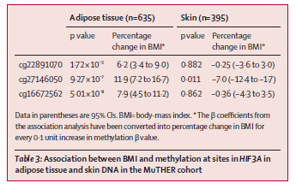
Main results
Notes:
Top-left: Association only in methylation of adipose tissue, not in skin tissue.
Top-right: spatial relationship of CpG’s, SNPs and the HIF3alpha locus
Bottom: Mendelian-Randomization Study showing relation of two SNPs with methylation at top CpG in HIF3a

Slide 35
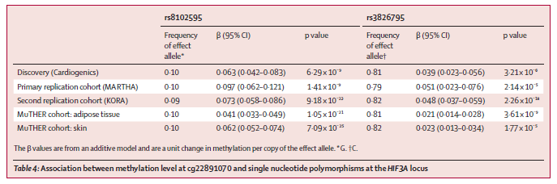
Main results
Notes:
Top-left: Association only in methylation of adipose tissue, not in skin tissue.
Top-right: spatial relationship of CpG’s, SNPs and the HIF3alpha locus
Bottom: Mendelian-Randomization Study showing relation of two SNPs with methylation at top CpG in HIF3a

Slide 36
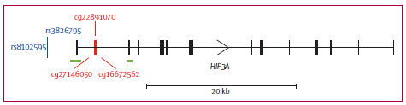
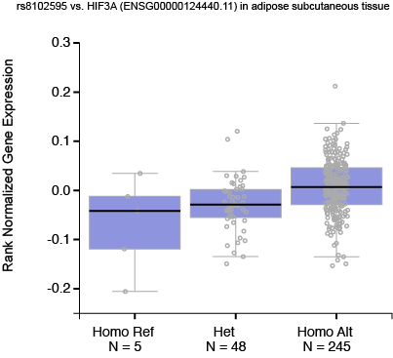
Main results
Notes:
Top-left: Association only in methylation of adipose tissue, not in skin tissue.
Top-right: spatial relationship of CpG’s, SNPs and the HIF3alpha locus
Bottom: Mendelian-Randomization Study showing relation of two SNPs with methylation at top CpG in HIF3a

Slide 37
CpGs aren’t SNPs
Eckhardt F. Nature Genetics; 38:12; 2006
Suzuki MM. Nature Reviews Genetics; 9; 2008
Notes:
Correlation is much less dense
Correlation is very tissue specific

Slide 38
CpGs aren’t SNPs
Eckhardt F. Nature Genetics; 38:12; 2006
Suzuki MM. Nature Reviews Genetics; 9; 2008
Notes:
Correlation is much less dense
Correlation is very tissue specific

Slide 39
CpGs aren’t SNPs
Eckhardt F. et al. Nature Genetics; 38:12; 2006
Suzuki MM. et al. Nature Reviews Genetics; 9; 2008
Liu Y. et al. AHJG; 94; 2014
Notes:
Correlation is much less dense
Correlation is very tissue specific

Slide 40
CpGs aren’t SNPs
Eckhardt F. et al. Nature Genetics; 38:12; 2006
Suzuki MM. et al. Nature Reviews Genetics; 9; 2008
Liu Y. et al. AHJG; 94; 2014
Notes:
Correlation is much less dense
Correlation is very tissue specific

Slide 41
Our research
A tip of the veil

Slide 42
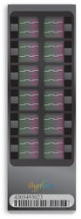
Methylomics in the AE
Only CEA patients, ~95% genotyped
Illumina HumanMethylation450K
450K CpG probes
Athero-Express Methylomics Study 1 (AEMS450K1)
487 plaque samples
91 blood samples
Athero-Express Methylomics Study 2 (AEMS450K2)
~400 plaque samples
Illumina HM 450K: 450.000 loci

Slide 43
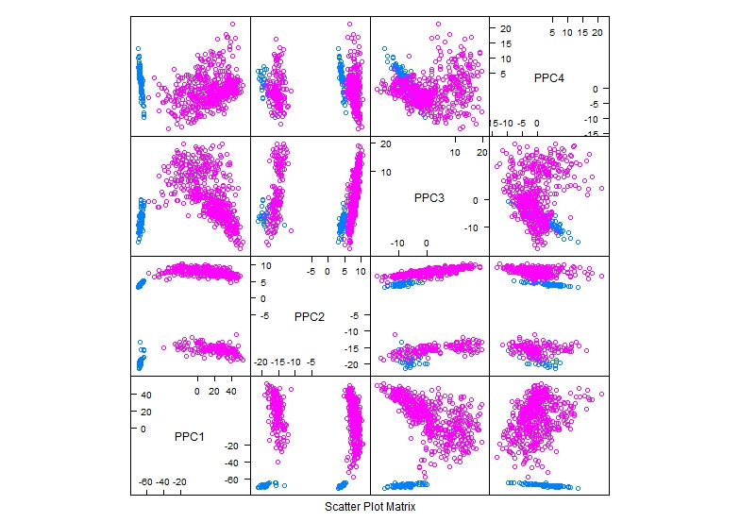
Methylation differs between blood and plaques

Slide 44
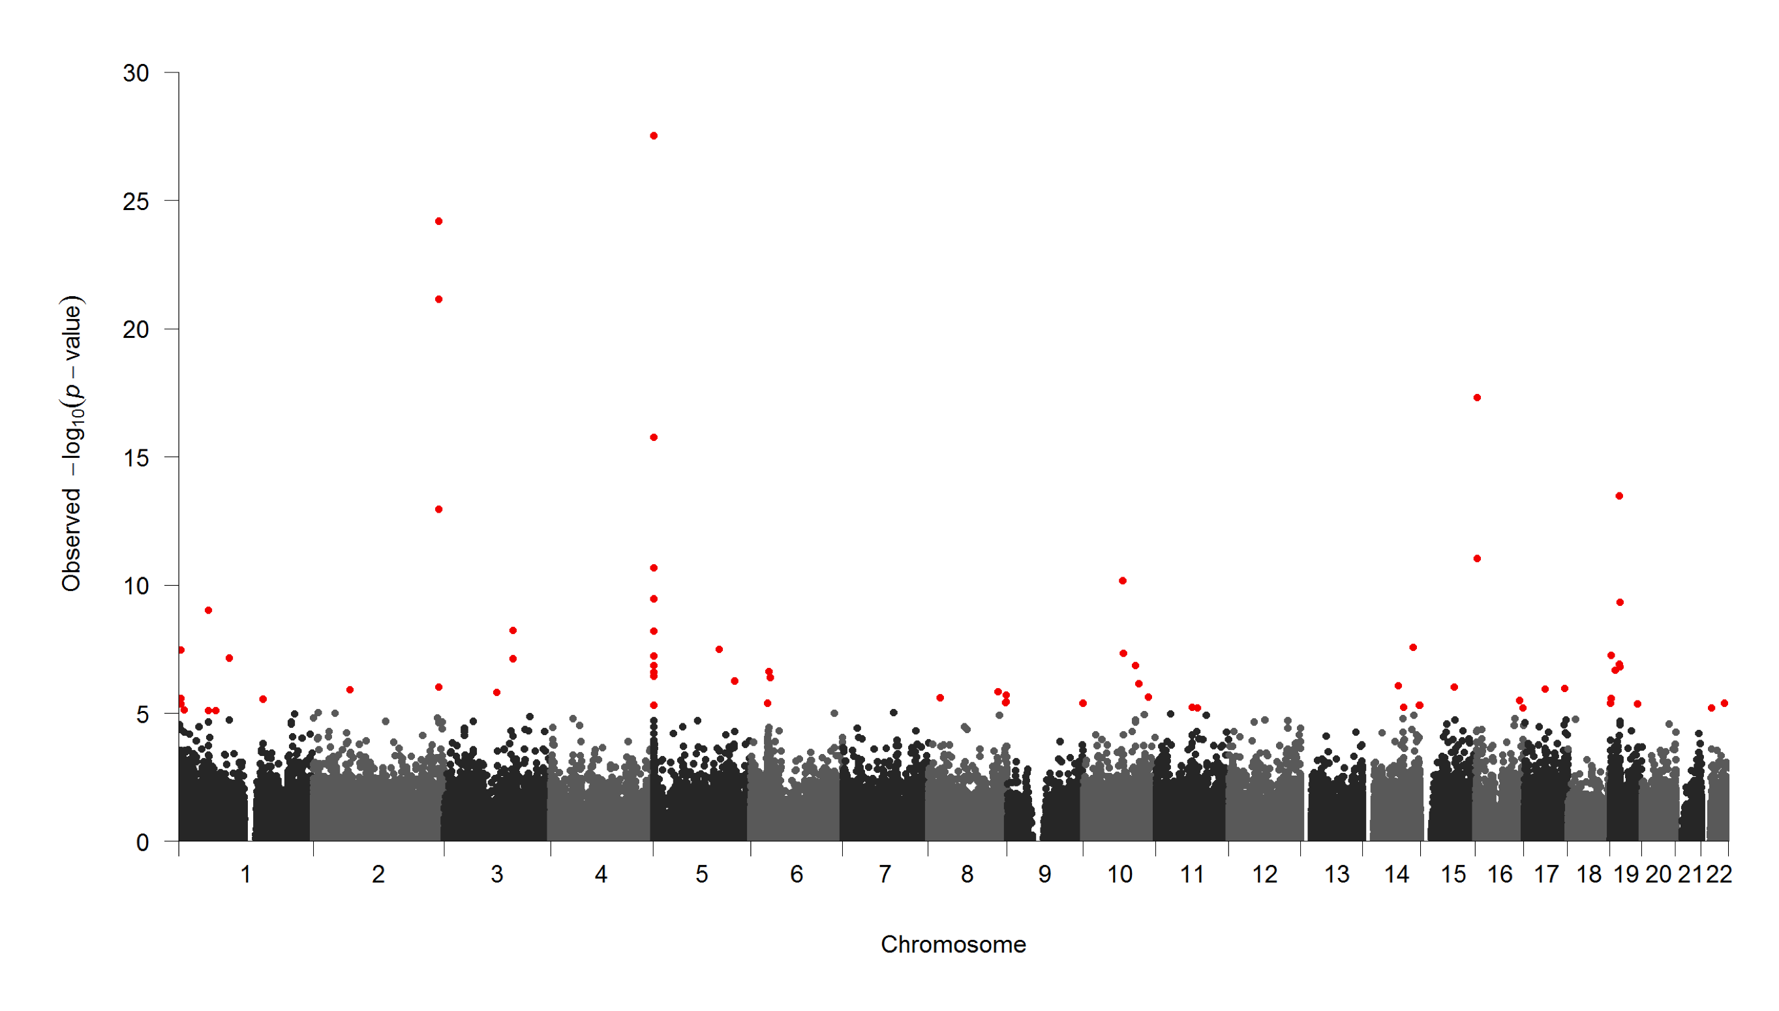
What is the impact of smoking on the arterial wall?

Slide 45
What is the impact of smoking on the arterial wall?

Slide 46
What is the impact of smoking on the arterial wall?

Slide 47




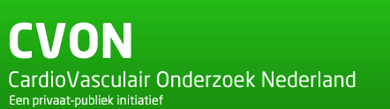
Cardiovascular Genetic Research
Laboratory of Experimental Cardiology
Dr. Sander W. van der Laan
Cardiology
Prof. Dr. F.W. Asselbergs
Dr. Jessica van Setten
Dr. Magdalena Harakalova
Research topics
Biomarker Discovery & Validation
Athero-Express | AAA-Express | CTMM
Ischemic stroke
GWAS | 4C | CRISPR-Cas9
Cardiovascular Genomics
Next-Gen Sequencing | eQTL | pQTL |
Transcriptomics | Epigenomics
S.W. van der Laan
s.w.vanderlaan-2@umcutrecht.nl | @swvanderlaan

